Slide 1
DATS 6401 – Visualization Complex Data Fall - 2019
Natural Disasters effect in Housing Pricing in USA
Mojahid Osman

Slide 2
Overview
Natural Disasters is the one of the most threaten to the people live in US, the natural disaster include but not limited to hurricane, tornado, storm, high water, wind-driven water, tidal wave, tsunami, earthquake, volcanic eruption, landslide, mudslide, and snowstorm.

Slide 3
Analysis FEMA data
In this section we are going to have more insight about how FEMA data looks like, and how its impacted USA states over the time, The below analysis will allow the user to create different views for the FEMA data using different filters like (Date, State & Disaster type).

Slide 4
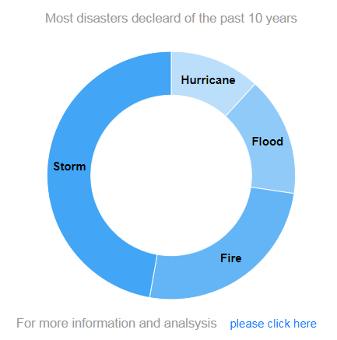
Analysis FEMA data - cont

Slide 5
Analysis FEMA data - cont
User also can see which most states impacted by which disaster, and the count of these disaster, also user can see the impact of these disasters over the time, Like the trend of the disaster over the time if any.

Slide 6
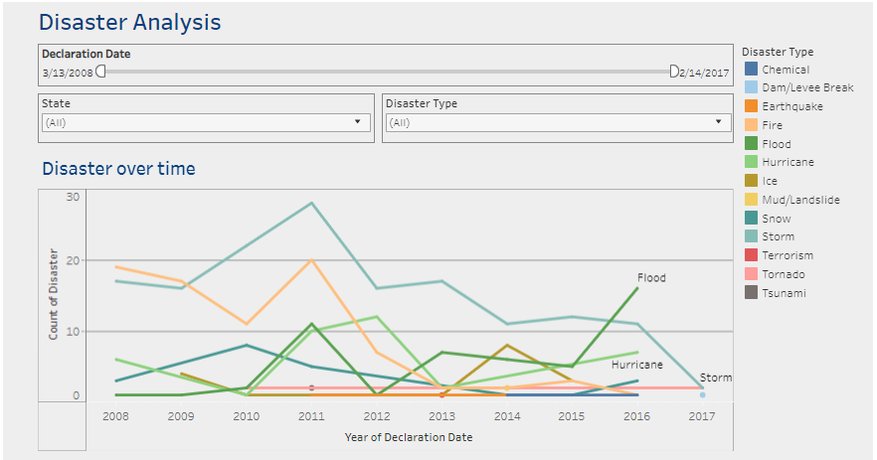
Analysis FEMA data - cont

Slide 7
Analysis Housing Price Data
Part of this project we are going to analyze the house pricing in USA using data from Zillow – one of the major real state databases in US – and we will be focusing on the Housing pricing change between based on the disaster declared.

Slide 8
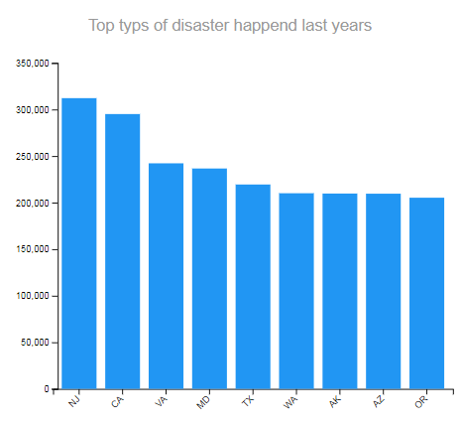
Analysis Housing Price Data - cont

Slide 9
Analysis Housing Price Data - cont
User also can see which most states has more Average sales prices and how these prices changing over the time.

Slide 10
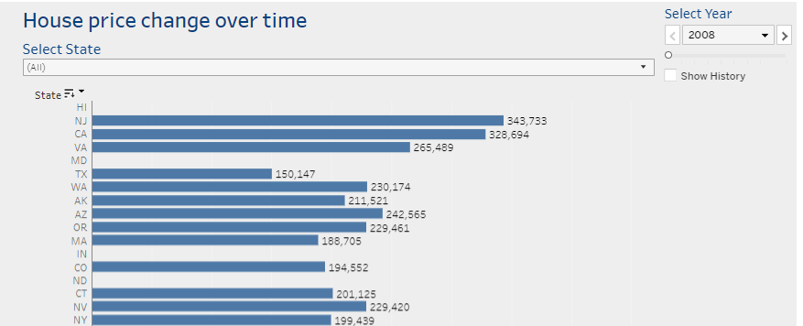
Analysis Housing Price Data - cont

Slide 11
Summary
Finally we added a map of the USA has both AVG Sales Price and Count of Disaster for each state over the time so user to can track the disaster for each state over the time and whether disaster affected the price or no.

Slide 12
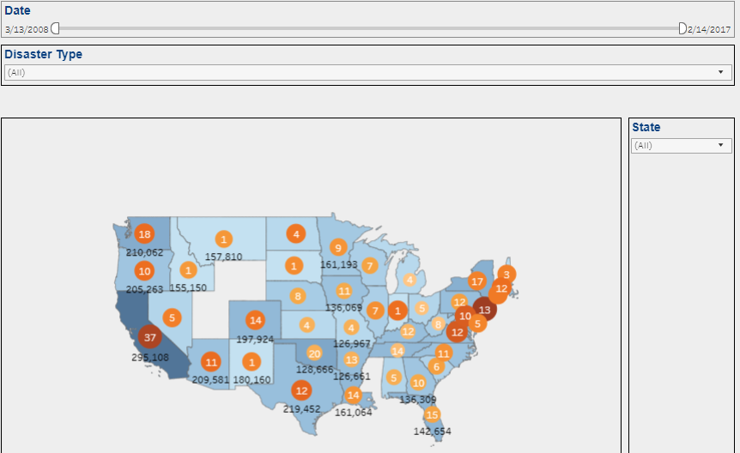
Summary

